Slide 1
DATA STRUCTURES WITH C
    SAHIL D JAIN
    SIDDHANTH SUBBAIAH

Slide 2
PRIORITY QUEUES

Slide 3
QUEUES
A queue is a linear abstract data type such that insertions are made at one end, called the rear, and removals are made at the other end, called the front.
Queues are sometimes called FIFOs: first-in first-out.
  enqueue() → Queue → dequeue()
The two basic operations are:
enqueue: adds an element to the rear of the queue.
dequeue: removes and returns the element at the front of the queue.
→Software queues are similar to physical ones: queuing at the supermarket, at the bank, at cinemas, etc.

Slide 4
PRIORITY QUEUES
Priority Queue is more specialized data structure than Queue. Like ordinary queue, priority queue has same method but with a major difference. In Priority queue items are ordered by key value so that item with the lowest value of key is at front and item with the highest value of key is at rear or vice versa.
So we're assigned priority to item based on its key value. Lower the value, higher the priority.

Slide 5
First-in First-out (FIFO)
The first one enqueued is the first one dequeued. (FIFO)
A, B, C come in
C
B
A
C
When we enqueue entries in the queue and then dequeue them one by one, we will get the items in the same order.
B
A
C
B
A
A, B, C come out

Slide 6
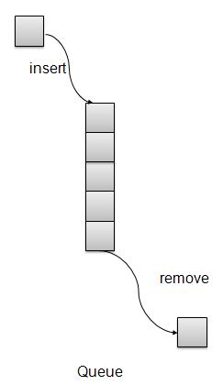
Priority Queue Representation

Slide 7
General Priority Queues
Priority Queue is an extension of queue with following properties.
1) Every item has a priority associated with it.
2) An element with high priority is dequeued before an element with low priority.
3) If two elements have the same priority, they are served according to their order in the queue.
A typical priority queue supports following operations.
insert(item, priority): Inserts an item with given priority.
getHighestPriority(): Returns the highest priority item.
deleteHighestPriority(): Removes the highest priority item.

Slide 8
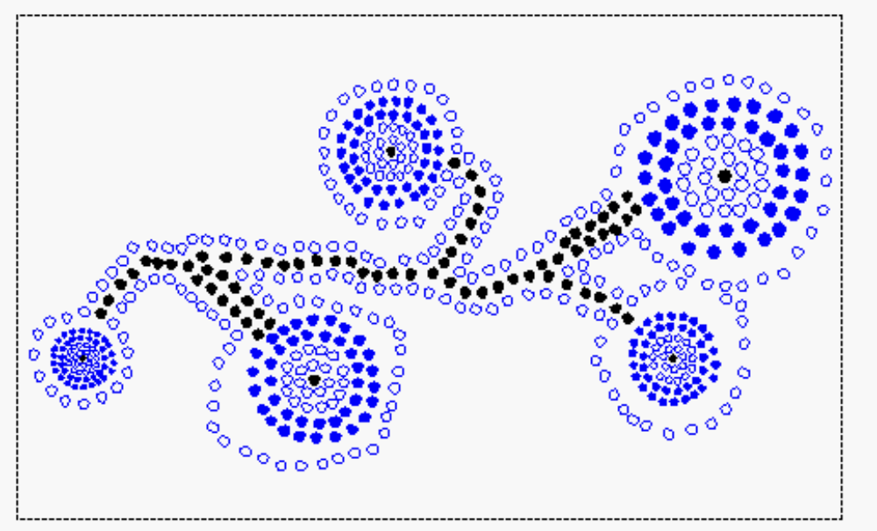
Priority Queues Applications
The priority queue ADT
Sorting
Comparators

Slide 9
The Priority Queue ADT
A prioriy queue P supports the following methods:
-size(): Return the number of elements in P
-isEmpty(): Test whether P is empty
-insertItem(k,e): Insert a new element e with key k into P
-minElement(): Return (but don’t remove) an element of P with smallest key; an error occurs if P is empty.
-minKey(): Return the smallest key in P; an error occurs if P is empty
-removeMin(): Remove from P and return an element with the smallest key; an error condidtion occurs if P is empty.

Slide 10
Sorting
A Priority Queue P can be used for sorting a sequence S by:
  inserting the elements of S into P with a series of insertItem(e, e) operations
  removing the elements from P in increasing order and putting them back into S with a series of removeMin() operations
  Comparators
The most general and reusable form of a priority queue makes use of comparator objects.
Comparator objects are external keys that are to be compared.
When the priority queue needs to compare two keys, it uses the comparator it was given to do the comparison.

Slide 11
THANK YOU

